Slide 1
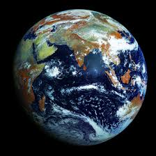
Good afternoon! (or morning or evening depending on where in the world you are!)
While we are waiting to get started, please drop me a “hello” in Chat.
I am interested to know:
Where in the world you currently are
What field of study your thesis is in.
Thanks!
Workshop resources will be emailed to participants soon after the workshop.

Slide 2
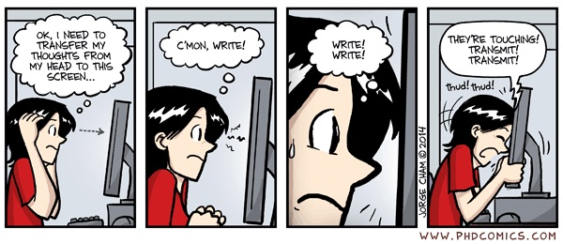
Writing a successful thesis for honours and coursework masters students
David Rowland
Learning Development
Student Services

Slide 3

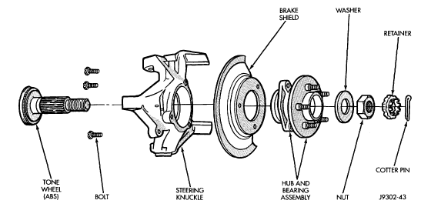
A⁺
Overview:
To write a successful thesis:
Manage the project & use productivity enhancing tools
Have a clear conceptualisation of what you are trying to achieve
Use the expectations of each structural element to construct effective structures / sections / chapters
Use editing guidelines and tools to effectively edit and proofread your writing

Slide 4


Two keys to success
1. See writing as part of the thinking process
and write up as much as you can as you go along.
2. Write to convince
and not just describe.
That your research was worth doing
That your methods were sound
That your conclusions follow from your findings
That your conclusions are worth remembering and using.

Slide 5
Overview:
To write a successful thesis:
Manage the project & use productivity enhancing tools
Have a clear conceptualisation of what you are trying to achieve
Use the expectations of each structural element to construct effective structures / sections / chapters
Use editing guidelines and tools to effectively edit and proofread your writing
Break the project down into tasks and sub-tasks & develop timelines
Maintain a close working relationship with adviser(s)
Write up (at least rough drafts) as you go
Use productivity enhancers efficiently
Because the bigger the job,
the better your processes need to be.

Slide 6
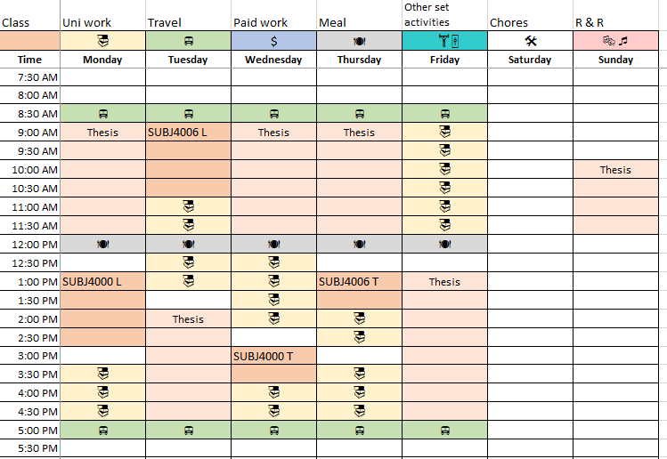
Project management
Break the project down into tasks and sub-tasks & develop timelines.
Keep in mind everything will take longer than you expect it will and allow buffer times for set-backs and delays.
Set-up a regular schedule of meetings with adviser.
Set some milestone deadlines.
E.g. when you will have draft sections to get feedback from your adviser on.
What fraction of your 40 hours per week should you be spending on your thesis? Block out those hours on a weekly planner.
Plan regular time for writing (when you are at your best because writing is hard!).
Read thesis booklet.
Set up thesis template in Word using CaST.
Set up EndNote library.
Read ethics requirements.
Obtain ethical clearance.
…

Slide 7

To write a successful thesis:
Maintain a close working relationship with adviser(s), but …
Based on the article by Hugh Kearns and Maria Gardiner, “The care and maintenance of your adviser”: http://www.ithinkwell.com.au/content/nature_2011_student_advisers.pdf

Slide 8

To write a successful thesis:
Write up as you go along!
(At least semi-polished / partial drafts)
To capture your thinking while it is still fresh
reduces stress at end
So you can get feedback while you still have time to act on it!
And so you can learn for later sections
And to give your advisor more manageable bite-sized chunks
To sharpen and clarify your thinking!!!
Write to develop your thinking, not just capture your thinking.
Writing – Reviewing – Rewriting = discussing and debating your ideas and their clarity of expression with yourself.
To help you learn the literature
Which helps you to sharpen and clarify your thinking

Slide 9
Key tips from, “Turbocharge your Writing Today” http://www.nature.com/naturejobs/2011/110707/pdf/nj7354-129a.pdf
Write before you feel ready — because you might never feel ready.
Don’t (necessarily) wait to have a clear picture of the paper. As you start putting down your ideas, you may actually clarify them.
Snack write — work in short, frequent bursts instead of waiting to sit down for big blocks of time. [It is easier to keep going than to get going.]
Set specific times in your schedule for writing [when you are freshest is best!] — don’t leave it to chance, because chances are it won’t happen.
Writing means putting new words on the page or substantially rewriting old words.
If you refrain from writing because you worry that what you write won’t be good enough, try noting the adage that to write well, you first have to write.
To really increase the quality and quantity of your writing, get feedback from mentors and colleagues — it can be painful, but it works.

Slide 10
Write what?
Introductions: to thesis, to chapters.
From very early on to help clarify in your own mind what you are trying to achieve and why.
May need later modification, but that’s okay.
Literature reviews
At least notes, tables or mind maps otherwise in one eye and out the other.
Methods:
Methods folder
think through carefully before collecting data / setting up experiments (though will probably get modified as a result of experience)
Results and analyses of these.
[Papers for publication: then thesis writing is more collation than a mountainous job.]

Slide 11

To write a successful thesis:
Use IT tools to improve your productivity and efficiency
(and reduce tedium and stress!)
Use bibliographic management software (e.g. EndNote, Zotero, Mendeley) to store and efficiently retrieve info on the outcomes of your searches.
Use Advanced Word features to save hours of tedium in constructing a large and linked document.
Use graphic organisers to cope with information overload.
See library guides and training:
https://web.library.uq.edu.au/research-tools-techniques/referencing-software
https://web.library.uq.edu.au/research-tools-techniques/referencing/referencing-software/endnote/using-endnote
Google: “Advanced Word UQ” for a library training guide.
Tables
Mind/concept maps
Argument maps

Slide 12
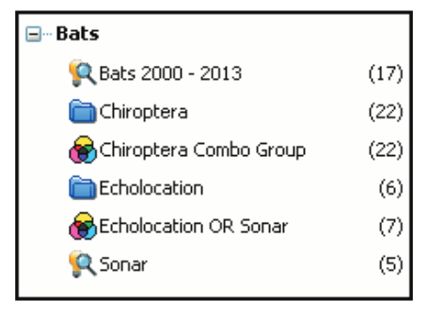
Organising your EndNote library
You may find it useful to “group” your references in some way. E.g. by:
Different important aspects of your research
Methodological issues
Level of evidence (e.g. randomised controlled trials vs case studies vs …)
Groups in an EndNote Library
EndNote example from http://endnote.com/training/mats/enuserguide/eng/endnote7/enguide-full.pdf p. 5-3

Slide 13
Some possible preliminary organising steps with EndNote (2)
You could also search groups or your whole library for articles which include one or more key words using Boolean operators.
But then you can only look at your notes on each article in the search group one at a time, which makes it hard to compare and contrast and synthesise.
In this situation, a supplementary Word or Excel table might be useful.

Slide 14
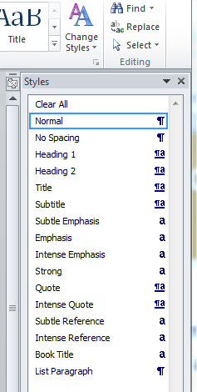
Get Word to do a lot of the “grunt work” for you
Use defined styles:
For consistent and automated formatting of headings etc.
So Word can generate and update a Table of Contents for you
Use built in captioning:
So Word will generate and update table, figure and equation numbers for you
So Word can generate and update Indexes of Tables and Figures for you
Use cross-referencing:
So that Word can update in-text references to numbered tables and figures for you.
Update document by: (a) Ctrl A, then (b) F9.
Learn how:
Google: “Advanced Word UQ”

Slide 15
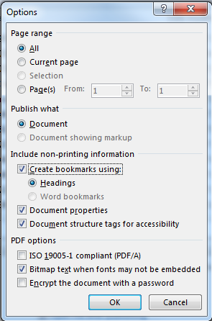

Creating an easily navigable, highly hyperlinked thesis
When saving as a pdf:
Click on “options”
Then select: “Create bookmarks”
Notes:
Illustrate value with “Hyperlinked physics thesis.pdf”
Sub-sections in bookmarks
Last results chapter for figures, references and equations.

Slide 16
Equations
It may be easier to just do things manually, but if you want to explore the arcane art of automating the formatting and numbering of display equations, see:
http://superuser.com/questions/594559/how-do-you-easily-add-equation-numbers-to-microsoft-word-2010-equations
http://blog.drscottfranklin.net/2014/03/03/how-to-insert-equation-numbers-in-word-2010/
And if you want to learn more about how to use Word’s equation editor efficiently, see:
http://www.iun.edu/~mathiho/useful/Equation%20Editor%20Shortcut%20Commands.pdf

Slide 17
Version Numbers
Before making major changes:
“Save as” filename-v2, filename-v3, …
How can you avoid mistakenly working on the wrong version?
File older versions in an “Archive” sub-folder.
Sort files in your folders by “Date modified”
If work at home and uni, make a USB your master storage place with home and uni hard drives as back-ups at the end of a session of work.
Save to the cloud.

Slide 18
To write a successful thesis:
Manage the project & use productivity enhancing tools
Have a clear conceptualisation of what you are trying to achieve
Use the expectations of each structural element to construct effective structures / sections / chapters
Use editing guidelines and tools to effectively edit and proofread your writing
Thesis must have a thesis
Thesis = idealised chronicle of the research journey
Write to explain and convince, not just describe
Good writing answers the reader’s questions

Slide 19


How to conceptualise your task
The goal of a research project is to make
an original,
worthwhile,
and sound
contribution to knowledge
and/or practice.
The goals of a thesis are to:
Convince readers that this
is what you have done
Document your work
for future reference.
Write well so that others would actually enjoy reading your thesis!

Slide 20


The way this achieved is by telling an idealised chronicle of your research journey
“Idealised” because you (generally) omit all the false trails and dead ends you went down during your journey / explorations.
Unless these are really interesting!
and by defending what you did and why you did it (that way).
Introduction
Methods
Results
Discussion
= what did you do and why did you think it was worth doing?
= how did you do it and why did you think your methods were sound and valid ?
= what did you find, how did you find it from your data, and how did you control for possible problems?
= what was the nature of your contribution, to what extent can we trust it, how can we understand it, why is it interesting / important, where to next?

Slide 21
Generic questions answered by the components
of an empirical research paper or thesis.

Slide 22
In some cases, even with empirical studies,
more descriptive section heading than IMRaD are possible.
THE ROCK ART SCENES AT INJALAK HILL: Alternative Visual Records of Indigenous Social Organisation and Cultural Practices: Inés Domingo Sanz: Australian Archaeology, No. 72 (June 2011), pp. 15-22
Abstract
Introduction
The Cultural Role of Rock Art in Western Arnhem Land
Brief Insights on Indigenous Social Organisation
Indigenous Social Behaviour in the Injalak Hill Rock Art Scenes
Scene 1: A Kunabibi or a Funerary Ceremony
Scene 2: The Ubarr (or Wubar) Ceremony
Scene 3: A Corroboree or Gift Exchange Gathering Dance
Conclusions: Exploring Indigenous Social Behaviour through Rock Art Scenes
“Background” on rock art which supports an argument that rock art is “a unique cultural resource to learn about Indigenous life as perceived by Indigenous people”.
= “Background” needed to analyse and interpret the rock art
= “Results”
Case studies

Slide 23
A topic-based structure is also possible
Introduction
Topic 1
Introduction
Sub-topic 1
Sub-topic 2
Sub-conclusion
Topic 2
Introduction
Analysis
Sub-conclusion
…
Conclusion
Revisiting Consanguineous Marriage in the Greater Middle
East: Milk, Blood, and Bedouins¹
[Introduction]
Debating Middle Eastern matrimonial exceptionalism
Genetic drawbacks of consanguinity
Lactase persistence and Arabian Bedouins
Gene flows into Arabia
Modeling selective pressures on Bedouin marriage
Support from the historical and ethnographic record
Bedouin marriage practices and the wider Arab world
Conclusion
Note that while experimental research often neatly separates methods, results and discussion, for theoretical theses or theses in the humanities, methods, results and discussion are often melded together and methods can be more implicit (not explained, just done: e.g. critical engagement with relevant literature on the topic) and their explication leads immediately to results.
Notes:
1. AMERICAN ANTHROPOLOGIST, Vol. 115, No. 3, pp. 374–387,

Slide 24
Good academic writing answers the reader’s questions.
And your reader wants to learn from your research.
So if you are a food technologist, what is wrong with this?
“The shelf life of some foods can be significantly extended by vacuum packaging or by replacing the air in the food container with an inert gas like N₂, a process known as modified atmosphere packaging (ref.).”
Which foods?
Why these foods?
How much by?
Why does this help?
Improved version: “In determining the best packaging for a food product, it is important to take into account that food quality can deteriorate not only as a result of bacterial or fungal action, but also as a result of chemical reactions. For example, lipids in foods can go rancid as a result of oxidation (ref.). If this is a problem for a particular food product, then the shelf life of this type of food can be extended by removing the O₂ from the food container either through vacuum packaging or by replacing the air in the container with an inert gas like N₂, a process known as modified atmosphere packaging (ref.).”

Slide 25
To write a successful thesis:
Manage the project & use productivity enhancing tools
Have a clear conceptualisation of what you are trying to achieve
Use the expectations of each structural element to construct effective structures / sections / chapters
Use editing guidelines and tools to effectively edit and proofread your writing
Abstract
Introduction
Literature review
Methods
Results
Discussion
For a topic-based thesis, these elements are often embedded throughout each section / chapter.

Slide 26
Abstract
The entire story of your research project,
in a nutshell.

Slide 27

Abstracts serve two purposes:
To help readers decide if they want to want to read your paper in any more detail.
To help readers keep up with the field with minimal effort.
To serve these purposes, abstracts should answer the following questions:
What needs motivated your research? (broad and specific)
How did you respond to those needs? (aim/objectives and methods)
What were the key outcomes of your response?
What are the implications / benefits / significance of your outcomes?
and so has a narrative structure. (Stories are easier to remember than lists of facts.)
Broad need = issue of concern / interest or motivating context.
Specific need = problem statement, a gap or deficiency and need to address.

Slide 28
Good abstracts tell the entire story of your research
by answering the key questions readers have about your research.
Broad need (motivating context)
Microalgae have potential applications for wastewater treatment and the bio-fixation of CO­₂, but key problems for large-scale planting of microalgae are the design, optimization and scale-up of high efficiency photobioreactors (PBR) for their culturing. As prior research had indicated that a key to improving the reaction efficiency of PBRs is achieving a high surface area to volume ratio (SVR), we designed and investigated a fractal tree-like PBR with high SVR. The basis of our PBR design was the bifurcation tree algorithm, itself based on the bionic fractal theory, and manufacturing was achieved using 3D printing technology. Numerical simulation and experimental results show that our fractal structure has a good flow performance and can lead to secondary flow, which is beneficial to enhance the turbulence and produce smaller bubble sizes. In addition, compared with multitubular PBR and conventional acrylic column reactors, Chlorella culture in the fractal tree-like PBR has a higher Fv/Fm (Chlorophyll fluorescence parameter), close to 0.767, and higher efficiency of photosynthetic growth as well as CO₂ capture. Therefore, the fractal tree-like PBR can improve the efficiency of light energy utilization and bioreaction. Combined with 3D printing technology, fractal PBR blazes a new trail for process intensification on the microalgae cultivation.
Specific need
Response (aim)
Response (methods)
Key outcomes
Implications
Notes:
Based on: https://doi.org/10.1016/j.ces.2018.08.057

Slide 29
Reinforcement: Good abstracts answer the key questions readers have about a piece of research.
“Various parts in gas turbine and waste incinerator plants are vulnerable to high temperature oxidation and corrosion. [but currently there does not exist a cost-effective, environmentally friendly approach to addressing this problem.]
Consequently, it was investigated whether protection from these problems could be provided by High Velocity Oxy-Fuel (HVOF) thermal spraying onto vulnerable parts, intermetallic compounds (specifically nickel aluminide, NiAl).
Initial results have shown that the coating provides improved properties compared with more conventional materials, such as other nickel alloys and stainless steel. In addition, some results in erosion testing showed that good corrosion resistance is combined with excellent protection against this form of wear.
The feasibility of using lower cost, less resistant substrates with a high performance protective coating [i.e. the approach used in this research] offers the possibility of enhanced cost effectiveness allied with increased serviceability and ongoing environmental benefits.”
What problem/need provided a motivation for doing the research?
Response / How was the need addressed? (aim + methods)
How was the investigation done and what were the key findings?
What is/are the significance, benefits or implications of the results?
Notes:
Adapted from: “Research results promise improved high-temperature coatings,” Metallurgia, June 1999.

Slide 30
Introduction
An argument that what you did was worth doing.

Slide 31
Establish significance of the research area
by providing motivating context, not simply “background”.
Q1: What is the is the general area you will be contributing to
and why is it worth contributing to?
E.g. Developing a cleaner, sustainable energy future for Mongolia.
✗
Background:
Mongolia is a developing country bordered by Russia and China with a population of just over 3.17 million people (ref.).
Motivating context:
Over the last 30 years, rapid growth in the population of Mongolia’s capital, Ulaanbaatar, has resulted in much of its 1.4 million people being off the electricity grid (ref). Since the temperature in Ulaanbaatar can drop to -30ºC at night in winter, this has resulted in a major pollution problem as much of the population inefficiently burns brown coal to stay warm (ref.). Consequently, in the winter months, the pollutant PM2.5 ... <is really bad>.
Tells me about Mongolia.
Reader’s response would be:
“Yes, so what? Why is that important to know in the context of your thesis?”
Starts to tell me why cleaner energy is a big concern in Mongolia. Note the features of an argument: ... since ... resulted ... consequently ...

Slide 32
Establish significance by providing background
the motivating context / rationale
Q1: Why is the broader research area interesting or important (to certain stakeholders)?
Your opening should make readers respond: “That sounds bad / important / interesting, what can be done about it?”
“Approximately 77,000 individuals are arrested in the United States each year based primarily on eyewitness testimony (ref.). … Given the pivotal role that eyewitness testimony plays in some trials, it is important to establish whether or not the jury’s faith in this testimony is warranted.” [1]
“Spent pot-lining (SPL) is a hazardous waste generated at the end-of-life of carbon cathodes in aluminium smelting electrolysis cells or pots, with an estimated 1 million tonnes produced worldwide every year [5,6]. … Degradation occurs as a result of …, resulting in environmentally concerning fluoride contents up to 20 wt.% and cyanides up to 1 wt.%. Fluoride is present as … and cyanides as ….” [2]
Note the highlighted words and phrases
which are indicating claims to significance.
Notes:
Note the words which indicate claims to the significance/importance of the area are being made.
Helen M. Paterson (2004), “Co-Witnesses and the Effects of Discussion on Eyewitness Memory.” PhD Thesis submitted to UNSW.
Separation and Purification Technology 61 (2008) 182–192

Slide 33
Establish significance by providing background
the motivating context / rationale
Q1: Why is the broader research area interesting or important (to certain stakeholders)? Curiosity driven research.
There are dramatic individual differences in behavioural reactions to novel social and non-social situations during infancy and toddlerhood (e.g., Rubin, Hastings, Stewart, Henderson, & Chen, 1997). When placed in unfamiliar situations, some children are relaxed, spontaneous, and display minimal distress. In contrast, children who are identified as behaviourally inhibited tend to show high anxiety; they often refuse to engage in play behaviour with unfamiliar peers and adults, and they stay in close proximity to their mothers (Rubin et al., 1997). Behavioural patterns that reflect the construct of inhibition in novel situations have been found in many cultures, however, the extent to which inhibited behaviour is displayed appears to vary across culture (e.g., Weisz, Suwanlert, Chaiyasit, & Walter, 1987).
I wonder why that may be the case?
Notes:
Text an adaptation of http://dx.doi.org/10.1037/0012-1649.34.4.677 by Kana Imuta.

Slide 34
Motivating your research: language
What gaps or deficiencies (specific needs)
mean more research is needed?
Note the importance of identifying strengths, not just weaknesses; the authors whose work you are critiquing may be your reviewers!
“Lung transplantation remains the only viable treatment option for many end stage pulmonary diseases …. However, longer term outcomes are compromised largely by the development of … (BOS). … There are very few viable treatment options, since immunosuppression strategies have not been able to prevent or reverse BOS significantly. Recent studies have shown that macrolides such as azithromycin may be able to prevent BOS in some cases. However, the mechanism of action of these macrolides is still unclear, and if the treatment is unsuccessful the only other option is re-transplantation. The pathogenesis of BOS remains poorly understood …” [1]
“The smart antenna is one of the promising techniques to overcome problems of multipath propagation and co-channel interference [in wireless communication networks]. In general, it is classified into switched-beam and adaptive arrays [1]. … The advantages of the switched-beam antenna are the simplicity of its tracking algorithm and low cost. However, it is limited in terms of combating interference. The adaptive array offers better performance in terms of fighting interference. However, this is at the expense of higher costs associated with the sophisticated signal processing algorithm and complicated hardware implementations. In this paper, we …, which provides an intermediate solution. ...” [2]
Notes:
Note the importance of identifying strengths, not just weaknesses, the authors whose work you are critiquing may be your reviewers!
Balarka Banerjee (2011): http://research-repository.uwa.edu.au/files/3248143/Banerjee_Balarka_2011.pdf
P. Ngamjanyaporn, M. Krairiksh and M. Bialkowski (2005), Microwave and Optical Technology Letters, 45, 411-415.

Slide 35
Gaps and deficiencies: Critical review language to try
Collect phrases from good writers in your field.
Gaps
Although research into <topic / question> has been done in <context>, it is uncertain whether these findings would also apply in <new context> because …
Due to considerable social changes over the last two decades, it is unknown whether <author’s> results still apply.
A key barrier to progress in <this field> is a lack of understanding of the mechanisms of …
Research on <question> has delivered conflicting findings, with some authors finding … (refs.) while others have found … (refs.). Resolving this conflict is important because …
To develop effective approach to dealing with <issue>, it is necessary to understand more fully the underlying mechanisms of …
Deficiencies
Results to date have been disappointing, with a continuing need to …
Due to <need> it would be valuable to improve current techniques in terms of <criteria>.

Slide 36
Flowchart of a research paper introduction:
Mosquitoes major health hazard
1. Significance: Why is it important to be able to accurately map the distribution of mosquito breeding pools and channels?
One method of population management is via habitat modification: flushing breeding pools
To do this, need to accurately map distribution of pools and channels
2. Originality/ Significance: Why shouldn't we be completely satisfied with existing approaches? (Provides motivation + directions for research.
Open vegetation: aerial photography and field surveys are effective
Under forest and other mangrove canopies: field work problematic
Remote sensing is needed
Some success with aerial photography and thermal imaging data, but limited because they measure canopy attributes and are restricted to clear sky conditions
Synthetic Aperture Radar (SAR) can penetrate canopy and cloud cover and because reflectivity is a function of water content, has been used to map flooded forests³
4. What still needs to be done?
5. Theory: How make progress?
Applications to date do not have sufficient resolution to map mossie breeding pools⁴; resolution depends on wavelength and polarization⁵
3. Prior research: How might the identified problems be solved?
Goal of study
Notes:
Based on: Knight, J., Phinn, S.R. and Dale, P. (1999) “Development of an Operational Approach for Mapping Mosquito Breeding Sites from Airborne Synthetic Aperture Radar,” NASA PACRIM Workshop, Maui High-Performance Computing Centre, Kihei, August 26-27. https://airsar.jpl.nasa.gov/news/dale.pdf

Slide 37
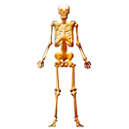
The SAR example’s argument in skeleton form:
Because mosquitoes are such a serious health hazard, it is important to keep their populations down.
One way of keeping populations down is to flush their breeding pools, but to do this, the distribution of breeding pools and water channels need to be accurately mapped.
Current mapping techniques, such as aerial photography and thermal imaging data, are limited because they cannot penetrate cloud cover or canopies.
SAR can potentially overcome these limitations because it can penetrate cloud cover and canopy and has been used to map flooded forests.
More research needs to be done however, because existing SAR applications have insufficient resolution, but this problem might be able to overcome by adjusting wavelength and polarisation ...
... and exploring that possibility was the aim of this research.
Establish importance of the “research territory”: Why is it important to be able to accurately map the distribution of mosquito breeding pools?
Identify a niche in the “research territory”: a place where an original contribution can be made: What limitations with existing techniques provide a motivation for doing some more research? How do you think you can address the limitations?
Occupy the niche: state what your aim / objective was.

Slide 38
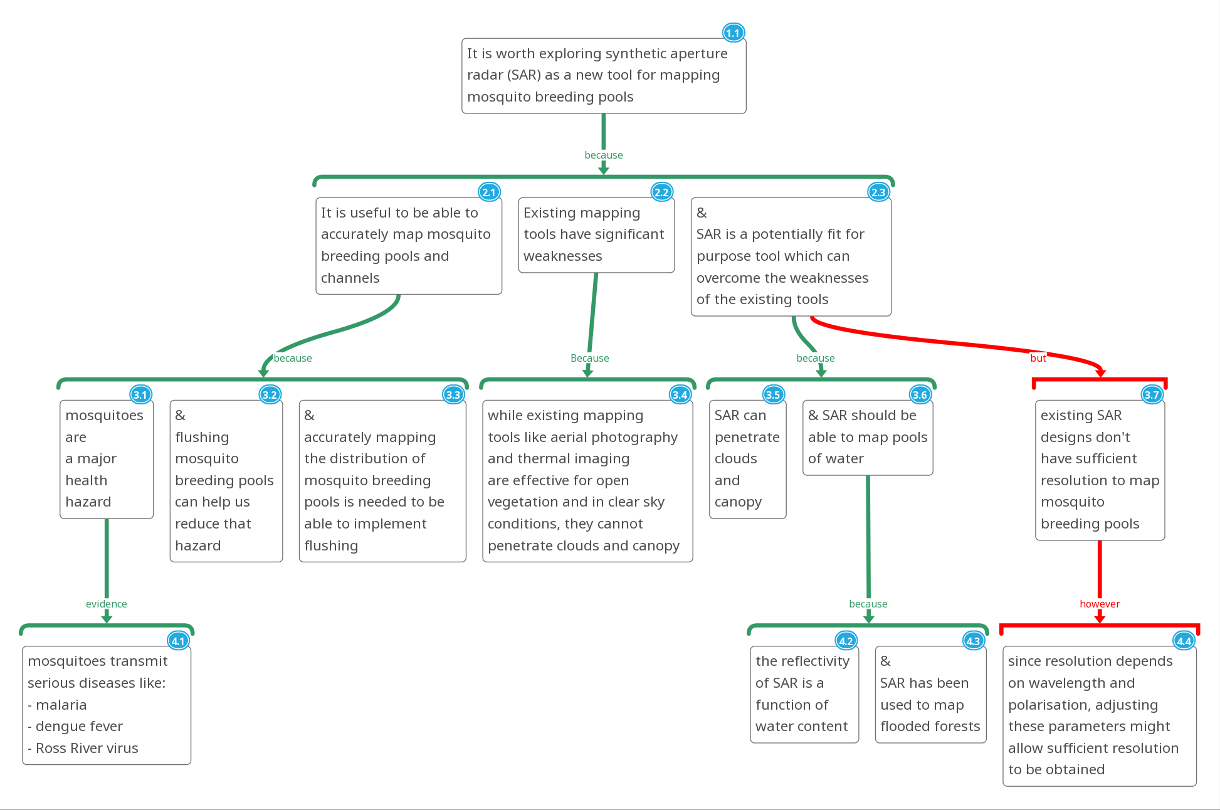
Example: Effective introductions are an argument that what you did was worth doing.
3(a) What do you propose to do and
(b) why do you think your idea might be what is needed?
1. Why do we need to do anything at all?
4. Why is some original research needed?
2. Why do we need something new?
5. What made you think your idea could work?

Slide 39
Example: Effective introductions are an argument that what you did was worth doing.
3(a) What do you propose to do and
(b) why do you think your idea might be what is needed?
1. Why do we need to do anything at all?
4. Why is some original research needed?
2. Why do we need something new?
5. What made you think your idea could work?

Slide 40

Good writing answers the reader’s questions,
so plan and focus your writing with focus questions.
The specific focus questions for the SAR introduction:
Why is there a need to be able to accurately map mosquito breeding pools and channels at all?
Why is there a need for a new technique? (What deficiencies in existing techniques would it be useful to address?)
Why did you think SAR might be a good option for a new technique?
What original research was needed in order to see if SAR could work?
Generic focus questions for an introduction:
What needs provided a motivation for your research?
How did you address those needs?
(May also include an outline: How do the pieces of your thesis fit together?)

Slide 41
Recap: What are the broad and specific needs motivating the research?
Broad need / motivating context | Specific need (a gap or deficiency)
Mosquitoes are a major health hazard. | D: Existing techniques for mapping the location of mosquito breeding pools have a significant limitation: they cannot see through cloud or canopy.
Indigenous languages are dying out. | D: Existing tools for preventing this loss of heritage give only a limited range of practice opportunities, and do not provide the feedback needed for optimal learning.
Many lung transplants fail within 7 years | G: Developing effective treatments is hampered by a lack of understanding of the biological mechanisms causing chronic rejection.
Toddlers differ markedly in the level of inhibition they show in unfamiliar situations. | G: It is unknown to what extent cultural differences can be explained by cultural differences in parenting style.
The threats of climate change mean we need to expand our supply of clean energy. | D: For wind power, this means putting wind farms on low wind speed sites for which existing turbine blade designs are inadequate both in terms of materials costs and structurally.
Notes:
Honours and masters students were unwilling to attempt this in Chat, so a discussion in breakout rooms may be better to try.

Slide 42
Practice: What are the broad and specific needs motivating your research?
Try to capture their essence in 2 sentences and drop in chat!
Broad need / motivating context | Specific need (a gap or deficiency)
Mosquitoes are a major health hazard. | D: Existing techniques for mapping the location of mosquito breeding pools have a significant limitation: they cannot see through cloud or canopy.
Indigenous languages are dying out. | D: Existing tools for preventing this loss of heritage give only a limited range of practice opportunities, and do not provide the feedback needed for optimal learning.
Many lung transplants fail within 7 years | G: Developing effective treatments is hampered by a lack of understanding of the biological mechanisms causing chronic rejection.
Toddlers differ markedly in the level of inhibition they show in unfamiliar situations. | G: It is unknown to what extent cultural differences can be explained by cultural differences in parenting style.
The threats of climate change mean we need to expand our supply of clean energy. | D: For wind power, this means putting wind farms on low wind speed sites for which existing turbine blade designs are inadequate both in terms of materials costs and structurally.

Slide 43

Explaining your research to others
will help you explain it better in your writing.
Pretend you need funding in order to pursue your research …
… and your neighbour has a pot of money.
You have 2 minutes to convince them that they should fund your project. (Then swap.) [This is the best way to “describe” your research!]
Do this by answering these 4 questions (1 min. to collect your thoughts first)
Why bother?
Question | Example (in brief)
1. Context: What broad need is providing the ultimate driver for your research? | The problems of global warming mean we need to expand our use of clean energy sources.
2. What specific need (gaps or deficiencies) provide a need for more research? | To expand wind farming we need to site them in low wind speed sites which requires longer turbine blades because …, but these longer blades are economically uncompetitive.
3. Response (objective + method): How are you addressing those specific needs? [“I am / My project …” first comes in here.] | By redesigning the blade to shift material from the box spar to the shell reduces material costs and addressed the bending problem.
4. Why do you think your direction is a promising one to take? | a. Reducing costs will make wind farms economically competitive. b. Redesign should be possible because …

Slide 44
Practice
Pretend you need funding in order to pursue your research …
… and your neighbour has a pot if money.
You have 2 minutes to convince them that they should fund your project. (Then swap.)
Do this by answering these 4 questions:
Why bother?
Question | Example (in brief)
1. Context: What broad need is providing the ultimate driver for your research? | The problems of global warming mean we need to expand our use of clean energy sources.
2. What specific need (gaps or deficiencies) provide a need for more research? | To expand wind farming we need to site them in low wind speed sites which requires longer turbine blades because …, but these longer blades are economically uncompetitive.
3. Response (objective + method): How are you addressing those specific needs? [“I am / My project …” first comes in here.] | By redesigning the blade to shift material from the box spar to the shell reduces material costs and addressed the bending problem.
4. Why do you think your direction is a promising one to take? | a. Reducing costs will make wind farms economically competitive. b. Redesign should be possible because …

Slide 45
Associated literature:
What do I need to make progress?
Deep understanding of problem trying to solve
Hypotheses to test / ideas to try
A theoretical / conceptual framework
To guide what questions to ask,
what observations to make.
To guide analysis and interpretation of “data”.
What’s been tried before
+ strengths and weaknesses
An appropriate methodology
Strengths / weaknesses of various approaches.
Measurement instruments: Validity and reliability.
E.g. parents asking children why they did something silly or naughty.

Slide 46
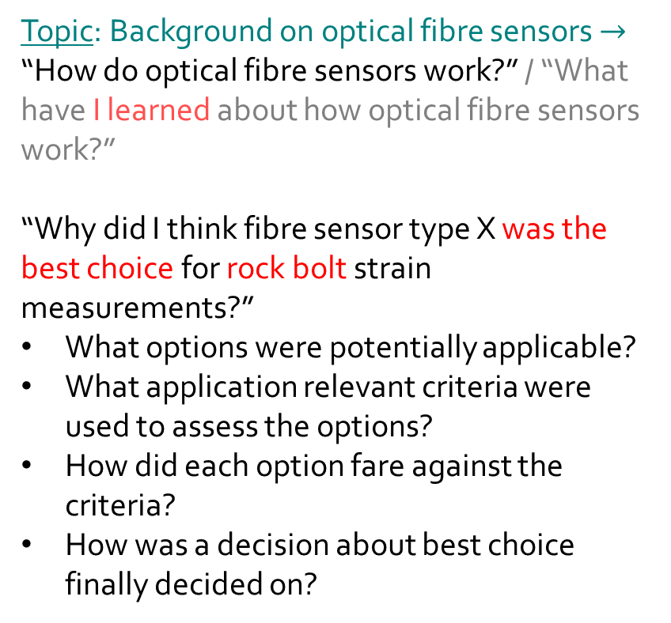
Turning topics to analytical questions focused on your research purposes helps focus your writing.
For a project exploring the use of an optical fibre sensor to detect possible failure of rock bolts in mining operations:
✗
Topic: Background on optical fibre sensors $→$
“How do optical fibre sensors work?” / “What have I learned about how optical fibre sensors work?”
“Why did I think fibre sensor type X was the best choice for rock bolt strain measurements?”
What options were potentially applicable?
What application relevant criteria were used to assess the options?
How did each option fare against the criteria?
How was a decision about best choice finally decided on?
Is this really a question your readers would want answered? Its focus seems to be on you rather than your project.
Focus now on project and this seems like a question readers would ask.
Note how one often needs to answer a series of sub-questions to answer an overarching question.
Criteria: Required sensitivity, dynamic range, capacity to survive in the operating environment, ease of use, cost, ...

Slide 47
Move from information giving to message giving
by indicating to you and your readers, the purposes in relation to your research objectives of each section of reviewed literature.
Information: the “What?”, but not the “So what?”
“Four different explanations have been offered for the memory conformity effect: (1) normative social influence, (2) informational influence, (3) biased guessing, and (4) modification of the memory.
These explanations are not necessarily mutually exclusive, however the research described in this thesis attempts to identify the mechanism most likely responsible for memory conformity following co-witness discussion by comparing predictions made by the alternative explanations.
To establish the predictions made by the alternative mechanisms in the context of co-witness discussions held under different circumstances, the theory and empirical evidence relevant to each of these explanations is first reviewed in this section, with the relevant predictions being made in the next. ...”
Relevance to thesis to established.
Purpose of section in relation to thesis goals made explicit.
Notes:
Source: Helen M. Paterson (2004), “Co-Witnesses and the Effects of Discussion on Eyewitness Memory.” PhD Thesis submitted to UNSW.

Slide 48
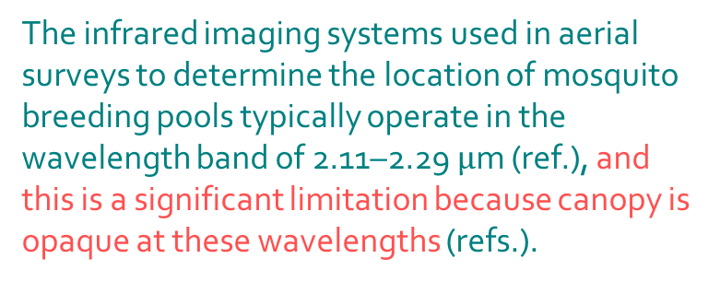
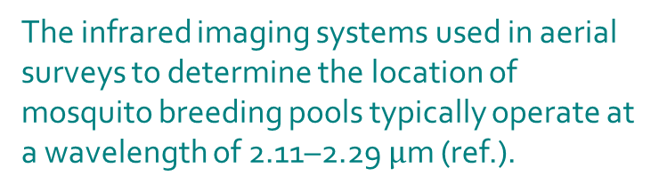
Good writing is convincing, and so consists of arguments.
Think: you are presenting the case for the prosecution in a court of law.
Description, or information,
only answers the what, but not the so what?
The infrared imaging systems used in aerial surveys to determine the location of mosquito breeding pools typically operate at a wavelength of 2.11–2.29 $μ$m (ref.).
A message is information with a point, and so answers the so what?
The infrared imaging systems used in aerial surveys to determine the location of mosquito breeding pools typically operate in the wavelength band of 2.11–2.29 $μ$m (ref.), and this is a significant limitation because canopy is opaque at these wavelengths (refs.).
An argument aims to convince, and so also answers why?
As canopy is opaque at the operating wavelength of infrared imaging systems (…), such systems can only indirectly determine the location of mosquito breeding pools by measuring canopy attributes (ref.), and this is a significant limitation.

Slide 49
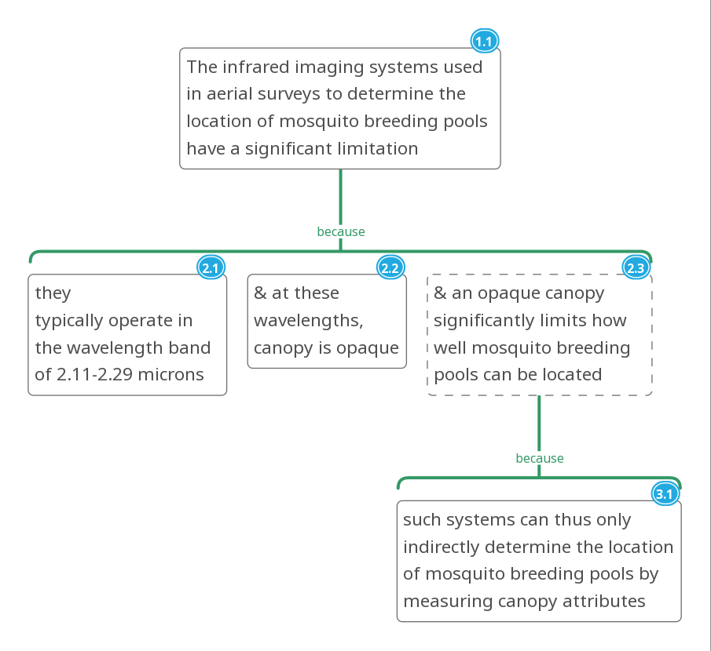

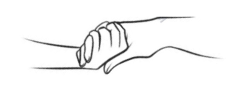
Argument maps help you understand the nature and structure of arguments.
Overarching claim
Rules for constructing good arguments:
Rabbit Rule: Every important component of a claim needs to appear in a supporting premise.
Why?
Grounds (evidence)
Warrants (reasons)
Holding Hands Rule: To work together to support a claim, co-premises must have something in common.
So what?
Sounds problematic, but why should we be so concerned about this?
What other evidence could strengthen the claim?
Map created with MindMup’s argument visualisation tool.

Slide 50
Argument maps help you understand the nature and structure of arguments.
Overarching claim
Rules for constructing good arguments:
Rabbit Rule: Every important component of a claim needs to appear in a supporting premise.
Why?
Grounds (evidence)
Warrants (reasons)
Holding Hands Rule: To work together to support a claim, co-premises must have something in common.
So what?
Sounds problematic, but why should we be so concerned about this?
What other evidence could strengthen the claim?
Map created with MindMup’s argument visualisation tool.

Slide 51
Even if you do not argument map, coloured highlighting can help you check the RR and HHR are being satisfied.
At first glance the following looks like quite a clear explanation:
“One difference among the world’s sea and oceans is that the salinity varies in different climate zones. There are two reasons for this (ref.). First of all, in warm climate zones, water evaporates more rapidly than it does in cold climate zones. Second, the surrounding land in warm climate zones tends to be drier, while in cold climate zones, there is considerable runoff created by melting snow.”
But the argument map reveals some problems:
The provided reasons are not explicitly linked to the phenomenon of interest:
What are the connections between the supporting premises and seawater salinity?
Notes:
The challenge of argumentative writing is that what appears clear to you is not clear to the reader because while you can subconsciously fill in all the missing pieces, the reader cannot.

Slide 52
Even if you do not argument map, coloured highlighting can help you check the RR and HHR are being satisfied.
One difference among the world’s sea and oceans is that the salinity varies in different climate zones. For example, the Baltic Sea in northern Europe is only one-fourth as saline as the Red Sea in the Middle East (ref.). There are two reasons for this (ref.). First of all, in warm climate zones, water evaporates rapidly; therefore, the concentration of salt is greater. Second, the surrounding land is dry; consequently, it does not contribute much freshwater to dilute the salty seawater. In cold climate zones, on the other hand, water evaporates slowly. Furthermore, the runoff created by melting snow adds a considerable amount of freshwater to dilute the saline seawater.
The related argument map:
Notes:
Adapted from: Oshima, A. & Hogue, A. (2006). Writing Academic English (4th Ed). Pearson Longman: White Plains, NY, USA. (p. 26)

Slide 53
Related literature review (methodological issue):
There are several maths anxiety assessment tools discussed in the literature. What are their respective pros and cons and what then were your justifications for choosing the tool you ended up using? [Good writing answers the critical reader’s questions.]
“There are many tools to assess maths anxiety and a well-recognised one is …. Due to its length, many researchers have found it too extensive to use which has led to the development of many shorter scales (refs.). One such shorter scale was developed by Betz (1978) who revised and created a tool to measure maths anxiety from … (ref.). Betz’s revisions consisted of ... The Betz questionnaire has been found to have good internal reliability, with Betz reporting a split-half reliability of 0.92, and other studies reporting Cronbach’s alphas of 0.72 and 0.90 (refs.). McMullan et al. (2012, p. 180) also report studies finding a test-retest reliability of 0.87 over a two-week period, and correlations of about 0.70 with the MARS scale. Consequently, it would appear that the Betz questionnaire has good psychometric properties, and given its brevity and adaptation to tertiary classrooms, and its apparently successful use in the McMullan et al. study with nursing students, it was believed to be a good maths anxiety questionnaire for this study.”
Notes:
Source: http://journal.aall.org.au/index.php/jall/article/view/424

Slide 54
Finding your direction
What do you need to know to make progress?
Broad research goal | Some specific review questions
Problem solving | What do we need to know about the causes of the problem to make progress? What new techniques or approaches might be tried and why might these be better than existing approaches? What do I need to know about these to be able to adapt them? What new understandings about the causes of the problem suggest new approaches to take? What alternative approaches to conceptualising the problem might lead to new and better ways of addressing the problem?
Filling a gap in understanding | What theories can guide: where to look for answers? how to interpret findings? how to conduct analyses? Possibly: Where is current theory deficient?
Evaluating something | What criteria will be used and why? How will you operationalise the criteria? (E.g. How will you judge “user friendliness” when evaluating a piece of software or some new electronic gadget?) What benchmarks will be used? (I.e. how will you determine what is good / satisfactory / poor?)
Improving something | What are the benefits of improvement / costs of not improving? What aspects are least satisfactory / most likely to lead to significant improvements if addressed and why? Why isn’t the thing working as well as we’d like? [Now see “problem solving” above.]
Resolving a conflict in the literature | What are the arguments and counter-arguments for and against different points of view? (This may involve reviewing different “schools of thought” about the research question, and a critical review of the theoretical foundations of each school of thought in the context of the research question. The aim is to identify potentially problematic assumptions which may need to be more carefully investigated.) What is needed to make progress with resolving the controversy?

Slide 55
Finding your direction
What do you need to know to make progress?
Broad research goal | Some specific review questions
Problem solving | What do we need to know about the causes of the problem to make progress? What new techniques or approaches might be tried and why might these be better than existing approaches? What do I need to know about these to be able to adapt them? What new understandings about the causes of the problem suggest new approaches to take? What alternative approaches to conceptualising the problem might lead to new and better ways of addressing the problem?
Filling a gap in understanding | What theories can guide: where to look for answers? how to interpret findings? how to conduct analyses? Possibly: Where is current theory deficient?
Evaluating something | What criteria will be used and why? How will you operationalise the criteria? (E.g. How will you judge “user friendliness” when evaluating a piece of software or some new electronic gadget?) What benchmarks will be used? (I.e. how will you determine what is good / satisfactory / poor?)
Improving something | What are the benefits of improvement / costs of not improving? What aspects are least satisfactory / most likely to lead to significant improvements if addressed and why? Why isn’t the thing working as well as we’d like? [Now see “problem solving” above.]
Resolving a conflict in the literature | What are the arguments and counter-arguments for and against different points of view? (This may involve reviewing different “schools of thought” about the research question, and a critical review of the theoretical foundations of each school of thought in the context of the research question. The aim is to identify potentially problematic assumptions which may need to be more carefully investigated.) What is needed to make progress with resolving the controversy?

Slide 56
Methods
Frame your writing as
how you achieved your research objectives,
and why you thought they were sound,
rather than simply a description of what you did.

Slide 57
The most informative methods explain and justify as well as describe,
and explain both research and methodological purposes of particular procedures.
Pure description only.
Gives the what, but not the why.
Methods explained: Procedures linked to both research and methodological goals.
Equivalated LSAT Logical Reasoning forms were administered to both seminar students and control students at the beginning and end of the semester (i.e., 85 days later). We randomly assigned 50% of students to form A as pretest and form B as posttest, reversing the order for the remaining students.
To assess whether this intensive training in argument visualization leads to generalized benefits for analytical reasoning, we administered equivalated LSAT Logical Reasoning forms to both seminar students and control students at the beginning and end of the semester (i.e., 85 days later). Students sat different but equivalated forms of the LSAT at pre- and post-test in order to control for gains that might arise from familiarity with the test rather than real learning gains. To control for possible differences between the forms, we used a counterbalanced design, randomly assigning 50% of students to form A as pretest and form B as posttest, and reversing the order for the remaining students.
✗

Slide 58
Methods: How you achieved your research objectives
To obtain a filter medium with size fractions of +0.55 to 0.83 mm, the quartz sand filter was dry sieved through stainless steel sieves. The filter medium was washed several times with deionized water, followed
by washing with ethanol until the surface of the quartz sand was free of impurities. Finally, the purified filter medium was dried at 110 ℃ for 12 h. The effect of any impurities on the filter medium surface was thereby substantially eliminated.
To estimate the absorption performance of the quartz sand filter, the water and oil absorption capacities of the pristine and OTS/ZnO-coated quartz sand filter media were measured.
The superhydrophobicity of the quartz sand filter media was assessed by the Krüss DSA100 Drop Shape Analysis System (Krüss, Germany). The contact angle values of water or oil drops (7 μL) on the quartz sand filter media surface were measured after 15 s under ambient conditions at a temperature of 20 °C.
https://doi.org/10.1016/j.colsurfa.2018.06.007

Slide 59
A checklist of things to consider when developing your methods section.
Sampling From where will you obtain the “data” you will use to answer your research questions? | What will the characteristics of your sample be? How will the sample be generated / how will the data be collected? If you intend to make novel equipment to generate your data, then details of the construction of that equipment needs to be given. What makes you think your sample will be sufficiently “representative” that valid conclusions could be drawn from it? How will your sample limit generalisability? What makes you think your sample will be better in some ways than the samples used by previous researchers in the field of study? What potential confounds do you need to control for, and how will you control for them? If you cannot control for all confounds, why do you think your research is still worth doing?
Measurement How will you “measure” the relevant variables? | What methodological design will you use and why do you think it is sound and appropriate given your goals and any relevant constraints? What choices of measurement instruments do you have, and why do you think that the one you will use is the best under the circumstances? What are the limitations (reliability, validity) of any measurement instrument you will use and why did you think it is worth proceeding with your research despite those limitations? How will you assess any reliability or validity issues and how do you intend to address or control for these issues?
Analysis How will you “analyse” your data? | How will you check your data for possible problems (e.g. missing values, “donkey voting”, data entry errors, outliers, …), how will you address any problems found, and what are your justifications for your “data cleaning” procedures? What analysis techniques, theories or prior work will inform your analyses? How will you use the techniques or theories to analyse your data? How will you check your analysis techniques are valid to use on your data? (E.g. some statistical techniques assume that the data is normally distributed, so did you check your data was at least approximately normal?)

Slide 60
A checklist of things to consider when developing your methods section.
Sampling From where will you obtain the “data” you will use to answer your research questions? | What will the characteristics of your sample be? How will the sample be generated / how will the data be collected? If you intend to make novel equipment to generate your data, then details of the construction of that equipment needs to be given. What makes you think your sample will be sufficiently “representative” that valid conclusions could be drawn from it? How will your sample limit generalisability? What makes you think your sample will be better in some ways than the samples used by previous researchers in the field of study? What potential confounds do you need to control for, and how will you control for them? If you cannot control for all confounds, why do you think your research is still worth doing?
Measurement How will you “measure” the relevant variables? | What methodological design will you use and why do you think it is sound and appropriate given your goals and any relevant constraints? What choices of measurement instruments do you have, and why do you think that the one you will use is the best under the circumstances? What are the limitations (reliability, validity) of any measurement instrument you will use and why did you think it is worth proceeding with your research despite those limitations? How will you assess any reliability or validity issues and how do you intend to address or control for these issues?
Analysis How will you “analyse” your data? | How will you check your data for possible problems (e.g. missing values, “donkey voting”, data entry errors, outliers, …), how will you address any problems found, and what are your justifications for your “data cleaning” procedures? What analysis techniques, theories or prior work will inform your analyses? How will you use the techniques or theories to analyse your data? How will you check your analysis techniques are valid to use on your data? (E.g. some statistical techniques assume that the data is normally distributed, so did you check your data was at least approximately normal?)

Slide 61
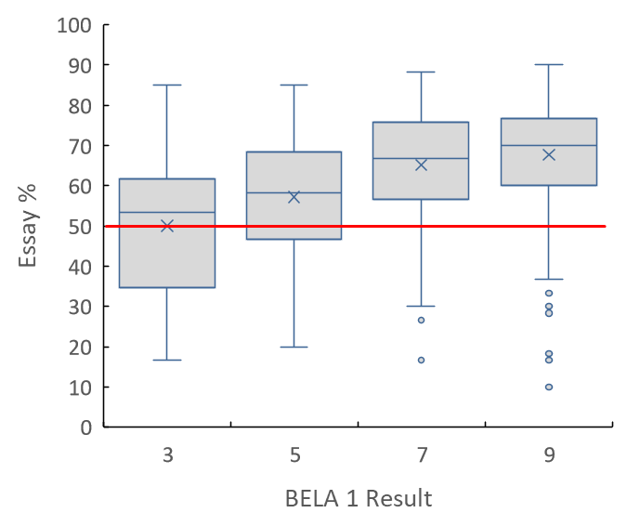
Results:
What did you find?

Slide 62
Results: Link explicitly with aims/objectives/hypotheses
“In relation to the first hypothesis that ,hypothesis>, it was found that ...”
“In relation to the question of <question>, it was found that ...”
Do not make your reader flick back several pages or chapters to find out exactly what your first hypothesis or research question was by writing something like:
“In relation to the first hypothesis, it was found that ...”
✗
Notes:
Make point about need to repeat hypotheses / questions for reader’s benefit.

Slide 63
Results:
Incorporating tables and figures effectively
There should be a clear purpose for including
any table or figure in a paper,
and that purpose should be clear from the title or caption.

Slide 64
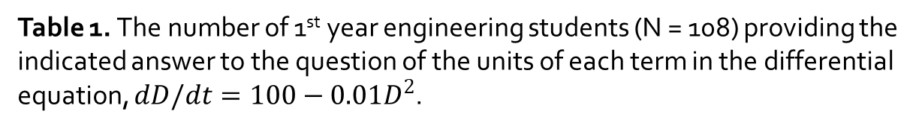
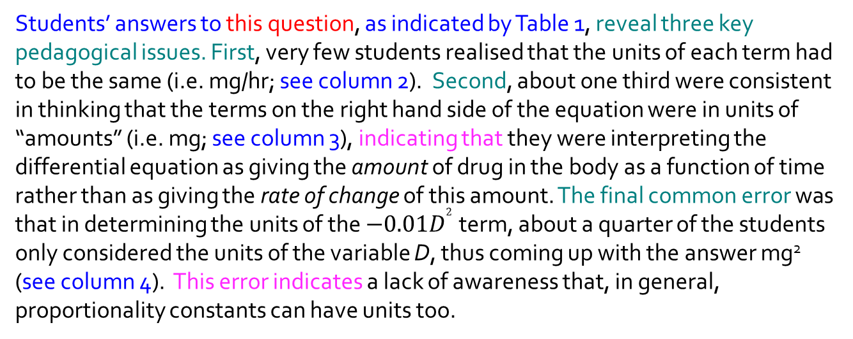
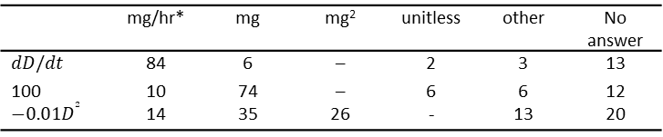
Effective discussion of tabulated data.
Student Understanding of the Units of Terms in Differential Equations
Nearing the end of … students were given the following diagnostic question to answer in class.
Question: A new type of drug …
Students’ answers to this question, as indicated by Table 1, reveal three key pedagogical issues. First, very few students realised that the units of each term had to be the same (i.e. mg/hr; see column 2). Second, about one third were consistent in thinking that the terms on the right hand side of the equation were in units of “amounts” (i.e. mg; see column 3), indicating that they were interpreting the differential equation as giving the amount of drug in the body as a function of time rather than as giving the rate of change of this amount. The final common error was that in determining the units of the $−0.01D^{2}$term, about a quarter of the students only considered the units of the variable D, thus coming up with the answer mg² (see column 4). This error indicates a lack of awareness that, in general, proportionality constants can have units too.
Table 1. The number of 1st year engineering students (N = 108) providing the indicated answer to the question of the units of each term in the differential equation, $dD/dt=100−0.01D^{2}$.
 | mg/hr* | mg | mg² | unitless | other | No answer
$$dD/dt$$ | 84 | 6 | – | 2 | 3 | 13
100 | 10 | 74 | – | 6 | 6 | 12
$$−0.01D^{2}$$ | 14 | 35 | 26 | - | 13 | 20

Slide 65
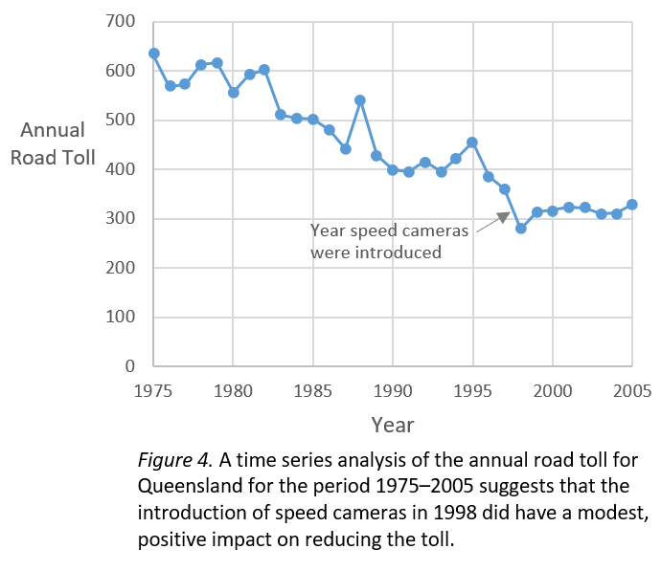
Elements of a discussion of graphical data.
Hard to read version
Figure 4 shows the annual road toll in Queensland from 1975–2005. Note that the road toll dropped from 360 at the end of 1997, to 279 at the end of 1998, the year speed cameras were introduced. However, while this drop suggests that speed cameras had a significant impact on the road toll, in 1999, 2000 and 2001, the annual road toll rose back up to 314, 317 and 324 respectively, which suggests ...
✗
Easier to read version
It is not straightforward to determine what impact the introduction of speed cameras in Queensland in 1998 had on the annual road toll. This difficulty arises because, as Figure 4 shows, while there was a 21% drop in that year, this drop needs to be considered in light of: (i) a significant pre-existing downward trend since 1975, (ii) sizeable random variations in the road toll of a similar magnitude (e.g. 1995–1996), and (iii) the fact that a significant fraction of this gain was lost in subsequent years. Nevertheless, a time series analysis taking into account the above effects (Appendix A) suggests that almost half of the drop could be the result of the introduction of speed cameras, assuming there were no other important changes made at the same time.
Caption with a message: the what
and the so what.
Message captions means readers can make sense of figure independently of the body text.

Slide 66
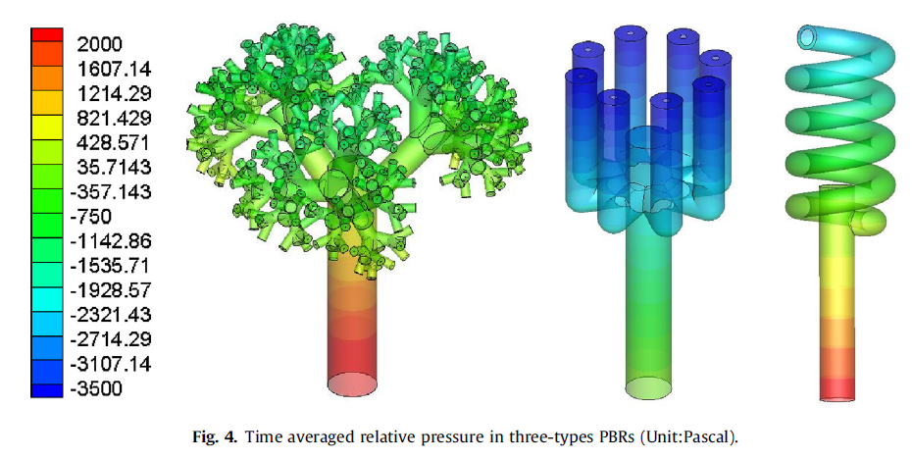

Turn captions from mere labels to key messages:
What? $→$ So what?
The what?
showing that the relative pressure differences between inlet
and outlet of the fractal tree-like PBR is the smallest.
The so what?
Notes:
https://doi.org/10.1016/j.ces.2018.08.057

Slide 67
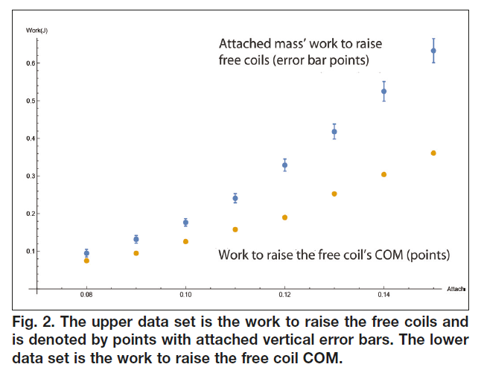
Some other issues to pay attention to.
Better proximity and matching colour can strengthen link.
Ensure axis labels and titles are readable at the size the figure will be reproduced at.
Work to raise the free coils’ COM.
Fig. 2. The work to raise the free coils was larger than that to raise the free coil COM. (Error bars are SEMs.)
Need to specify if error bars are SEMs, 95% CIs, SDs or even IQRs as there is no uniform convention.
Source: Phys. Teach. 58, 198 (2020); https://doi.org/10.1119/1.5145416

Slide 68
How to incorporate tables and figures effectively:
Important features generally best described qualitatively as humans cannot cope with more than a couple of numbers in a paragraph of text: that’s why we plot things in graphs!
But sometimes it can be useful to highlight one or two key numbers.
Before, otherwise readers won’t know what they are looking at and why.
Where should the text which refers to a table or figure go in relation to that table or figure, before or after? Why?
What sorts of things should the text say about a table or figure? Why?
If tables and figures are talked about in the main text, why do they need titles or captions?
Why are tables and figures numbered? (At least two reasons.)
What is a key characteristic of a good discussion?
The nature of the contents
Important features
Conclusions / implications
So readers can locate and understand tables and figures independently of the main text
Place to put explanatory notes.
Easy to refer to, easy to find.
Moves from making observations, to discussing the implications for stakeholders.

Slide 69
Discussion

Slide 70
What do readers expect in the Discussion and why do they want those things?
(E.g. from Mamun et al. 2007: Addiction, Vol. 102, Iss. 4, Pages: 647–654)
What were the key findings in qualitative form?
Helps the reader understand what the statistics are saying and provides focus for subsequent discussion.
In this prospective follow-up study of mothers and children, we found that ... These associations were independent of ... These findings provide evidence for ...
There are several possible explanations for the association between CSA and young adult nicotine disorder. One possible mechanism is ...
Another possibility is that ... However, this is unlikely as ...
Alternatively, experiencing CSA may lead to ...
Our results are consistent with previous studies where researchers have found ... Our study adds to the existing literature, as we found ... This finding supports a growing literature documenting that ...
How can we understand the findings theoretically?
Readers want understanding and not just facts.
If the unlikely possibility is not discussed, the reader does not know if this is just because the writers didn’t think of it or because it is unlikely.
How do the findings compare with what others have found and what has been added?
Aids understanding + establishes original contribution.
Notes:
Why discuss an unlikely explanation?

Slide 71
DISCUSSION (Mamun et al. 2007) cont’d
Our study has several important strengths. It is the first to ... and we have been able to adjust for a range of ... confounding and mediating factors. In addition, we have used ...
The major limitation of this study was substantial non-participation at 21 year follow-up. Our results would be biased if ... However, as most studies find that ... this is unlikely. In order to assess further whether those lost to follow-up produced bias in our results, we ...We found no difference ... which suggests that attrition is unlikely to have biased our findings substantively. However, given the profile of respondents and non-respondents, those who not followed-up are likely to be at greater risk of ...
Another important limitation of our study ... However, this is less likely to occur ... as ...
Why should this paper be considered to be “strong” / “better than previous work?
Aims to convince editors to publish and readers to read.
What are the methodological limitations of the research and why are the results still trustworthy enough to publish?
Aims to convince reviewers and readers that work is still valuable even if not perfect.

Slide 72
DISCUSSION (Mamun et al. 2007) cont’d
Finally, although we have considered …, the specific mechanisms leading to nicotine disorder are uncertain and our study has limited capacity in this respect. Future studies, with greater capacity to answer this question, should not only assess the robustness of our findings but also explore the relationship between CSA and nicotine disorder further, and aim to increase our understanding of the mechanisms underlying the association. …
In conclusion, ...
Identify still unanswered questions.
Suggest what further research is needed.
Be explicit about “why?”, “how?” and “what?”
Why isn’t, “Further research is needed”, good enough???
What is the final takeaway message of the paper?
Reinforces main outcome of paper.

Slide 73
Notes on “Discussion” example
Step 1: Summarise key finding in verbal form (results were highly statistical).
Step 2: Relate findings to “theory”: We want understanding, not just “facts” + theory helps us generalise findings to other contexts and make predictions.
Why discuss an unlikely explanation?
Because the reader might wonder if that was a possible explanation and if you didn’t discuss it would wonder if you just didn’t think of it. Reviewers might query that possibility and ask you to discuss it.
Remember: Good writing answers the readers’ questions!
Step 3: Relate findings to other findings in the field (helps understanding) and identify what original contribution has been made (can’t get published if there’s nothing “new”).
Step 4: Identifying strengths = “sales pitch” for why paper worth publishing and paying attention to.
Step 5: What was the goal of the authors in the paragraph about a possible major limitation?
To convince reviewers and readers that the authors were aware of the problem, had thought about it, and had arguments for why the paper was still worth publishing / the findings were still trustworthy.
Step 6: Final “takeaway message” of paper.

Slide 74
Postscript: Relating your work to previous research
Does your work:
Confirm?
The predictions of a theory?
Why are we now more confident about previous findings? (Originality often in methods.)
Extend?
Previous research might have found that team social integration is important for team performance, while yours showed that if social integration gets “too high”, it is counterproductive.
Improve? [a “different” approach is not enough]
In engineering: is your solution faster / more energy efficient / less polluting / more accurate / ....?
In medicine: is your new drug more efficacious / has much reduced side effects / ...?
Challenge?
Previous research has found X, but you found Y.
And why should we think you are “right” and they are “wrong”?

Slide 75
Abdullah A. Mamun, et al. (2005). Hypertension, 45, 1083-1087.
What further research is needed, why is it needed, and how can it be done? (NOT simply: “More research is needed.”)
There’s kudos in being cited, and encouraging follow up research by others can help achieve that.
Thesis examiners are also examining how much candidates have developed as researchers, which includes being able to identify next steps in research and how things can be improved.
... Future research should focus on two important extensions of the work presented here. First, we need to understand the important determinants of change from overweight/obese status to normal BMI and, in particular, the determinants of this change that are related to blood pressure change. Randomized trials of interventions to treat obesity in childhood should aim, and have sufficient power, to examine other outcomes in addition to weight loss. Specifically, they should aim to examine cardiovascular disease risk factor end points, including blood pressure, fasting lipids, and fasting glucose. Secondly, future research should examine the relationship between … With the evolution of a number of birth cohorts, including long-term follow-up of the MUSP study, it will be possible to determine whether the effects we report here do extend into effects on adult cardiovascular disease risk.

Slide 76
To write a successful thesis:
Manage the project & use productivity enhancing tools
Have a clear conceptualisation of what you are trying to achieve
Use the expectations of each structural element to construct effective structures / sections / chapters
Use editing guidelines and tools to effectively edit and proofread your writing
Write well so that others would actually enjoy reading your thesis!

Slide 77

Manage information overload with graphic organisers
Tables
Mind maps
Concept maps
Argument maps
Flowcharts
Compare, contrast & evaluate ideas / theories
Think: “product comparison tables”
Organise content for “big” writing or presentation projects by category and sub-category
Think: “jigsaw puzzle strategy” and multi-level table of contents
Indicate the relationships between the concepts which make up a body of knowledge.
Think: “knowledge schema”
Develop reasoning and critical thinking skills
Think: “claims, evidence, reasons, objections, & rebuttals”
Organise procedures / processes / strategies
Think: “recipe / algorithm”

Slide 78
An alternative approach is to use an indented dot point list
How can dentists improve the effectiveness of their approaches to oral health promotion in the clinical encounter?
Dentists [no room for the questions here.]
Improve the effectiveness of their approaches
What are their current approaches?
Why do they need improving? / What evidence is there that they aren’t as effective as desired?
What do we know about why these approaches aren’t effective?
Where might we look for better approaches?
Has any other health field had better success?
If so, what approaches do they use?
Why are they more effective?
Might they work in the dental setting?
Oral health promotion
Why is oral health promotion important?
What are the costs / consequences of not doing this well?
How many people have problems that could be prevented by better oral health practices?
What sorts of things need to be promoted?
What are the challenges of promoting these things to the general public?
Clinical encounter
How does this limit what could be feasibly done?
Questions provide a framework for organising notes and then writing sentences and paragraphs.
Notes:
Based on: ADJ 2009; 54: 190–197: doi: 10.1111/j.1834-7819.2009.01118.x
Dentists questions: How easily could dentists train up in these methods? Are they likely to find them an approach which they would be comfortable using?

Slide 79
To ensure you are covering all the important questions, and to start thematically organising them, it helps to:
Frame your research as a question. (Your short answer to this question is your “thesis”.)
Break that question into its component parts.
Decide what questions and sub-questions need to be answered in relation to each component part from the target audience’s perspective and from yours to develop your thesis.
Take into account course learning objectives as stated in the ECP.
As you do research, you may realise / discover more questions to add to your list.

Slide 80
Then turn that list of questions
into a “table of contents” with a logical order.
E.g. How can dentists improve the effectiveness of their approaches to oral health promotion in the clinical encounter?
Why is oral health promotion in the clinical encounter important?
How many people have problems that could be prevented by better oral health practices?
What sorts of things need to be promoted?
What are the costs / consequences of not doing this well?
What are the current approaches and why do we need something new?
What evidence is there that they aren’t as effective as desired?
What do we know about why these approaches aren’t effective?
What approaches in other (health) fields have had better success and will be considered in this essay?
Approach A: Motivational Interviewing (MI)
How does MI work?
What are the theoretical underpinnings of MI?
Where has it been applied and how successful has it been?
Why do I think it is suitable for the dental situation?
How would it work in the dental situation?
Approach B: …
Can assess the structure of your draft by turning it into a plan like this.
6. According to a set of criteria, which approach do I think is most worth implementing?
Notes:
Based on: ADJ 2009; 54: 190–197: doi: 10.1111/j.1834-7819.2009.01118.x
Dentists questions: How easily could dentists train up in these methods? Are they likely to find them an approach which they would be comfortable using?

Slide 81
Notetaking under an indented outline plan
Rx Q: How do pay for performance (PFP) schemes impact individuals, teams and firms?
Types of PFP schemes?
Individual
<Approach 1 (ref. 1)>
<Approach 2 (ref. 2)>
Team
<Approach 1 (ref. 3)>
Why do firms use PFP schemes?
(Hope) to improve employee innovation (ref. 1, ref. 2, …)
But note: outcome does not necessarily equal aim (ref. 4)
(Hope) to attract and retain high performing staff (refs. 1, 2, …)
Because it is an industry expectation (refs. 1, 2, 5)
What might happen if you don’t follow the industry expectations?
Impacts on individuals?
…
<How well do they help to attract and retain high performing staff?>
Potential negative impacts
Aversion to risk
<reasons (refs.) + evidence (refs.)>
Increased stress
<reasons (refs.) + evidence (refs.)>
Note organisation by key focus questions.
Add to as find more examples.
Note critical thinking questions to follow-up on.

Slide 82
Structured notes can help you
signpost the structure of your writing for readers.
Types of PFP schemes?
Individual
Approach 1 (ref. 1)
Approach 2 (ref. 2)
Team
Approach 1 (ref. 3)
Why do firms use PFP schemes?
Hope to ...
Impacts on individuals?
...
Potential negative impacts
Aversion to risk
<reasons (refs.) + evidence (refs.)>
Increased stress
<reasons (refs.) + evidence (refs.)>
E.g.
Pay for performance (PFP) schemes come in two broad types, individual based and team based, with sub-types within each type. Regarding individual based PFP schemes, ...
...
Although the corporate goal of PFP schemes is to improve individual and hence organisational performance, they can have potentially significant negative impacts which are counterproductive, namely an aversion to risk (refs.) and increased stress (refs). Aversion to risk arises because ...

Slide 83
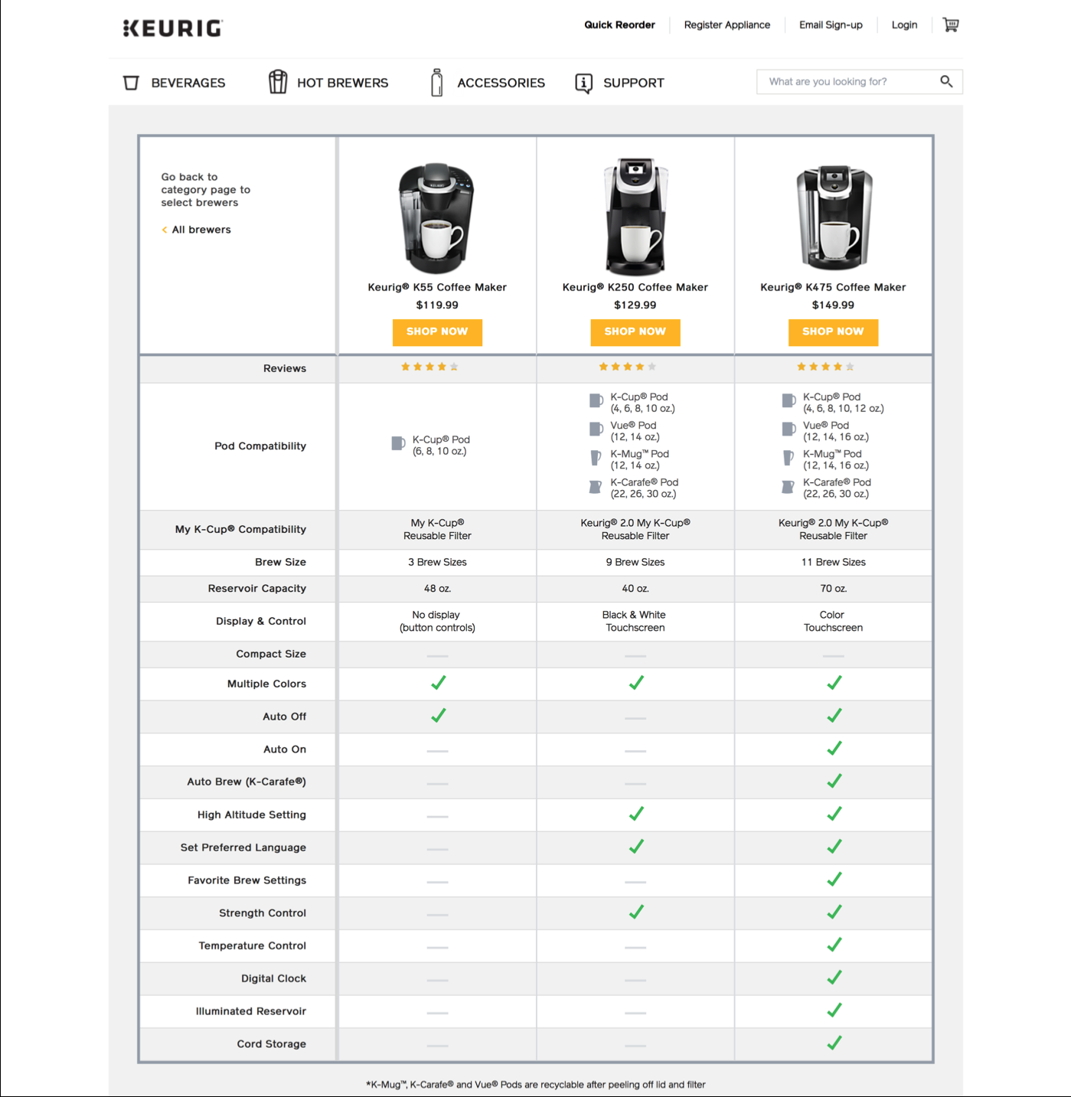
Compare & contrast theory / solution approach options with a “product comparison table”
Helps you to arrive at and justify your choices.

Slide 84
Product comparison tables are very helpful for comparing / contrasting different theories / approaches / …
Australian Industrial Relations Models | Centralised Arbitration (From early 1900s) | Enterprise Bargaining (Started in 1990s) | Individual Contracts (Some in 2000s)
Model Description | Workers organised into unions by occupation. Government set wages and conditions after listening to cases by unions and employers. | Unions based around individual businesses. Unions negotiated directly with employers. | Workers negotiate directly with employers. Only minimum safety net.
Values Differences
Worker quality of life vs business profits | Worker quality of life paramount. | Business needs are central. | Business needs are central.
Protecting vulnerable vs giving go-getters flexibility | Rigid rules protected the vulnerable, but restricted flexibility. | Some protection and some flexibility. | Prioritise flexibility.
Best way of dealing with conflict | Conflict settled by “central umpire”. | Can lead to significant conflict as both sides have similar power. | Reduces conflict by giving all power to employers.
Ref.: http://www.abc.net.au/radionational/programs/perspective/lindy-edwards/3220030

Slide 85
Table to text with parallel linking: Repeating a theme
but covering a different aspect of it.
There are three major values divides between the three different industrial relations models Australia has had since the early 1900s. As we've shifted models, we can see a gradual shift in Australian values. The first values divide has been over whether our work lives should be centred on delivering workers quality of life or maximizing business profits. Under the centralized wage fixing system, …. Under enterprise bargaining and individual agreements, the emphasis has shifted. People's working lives are expected to …. Business needs are at the centre. And we've moved to assuming that ….
The second values divide between these models is the way we balance protecting the vulnerable and allowing flexibility to the go-getters. On the one hand, arbitration …. Enterprise bargaining offered …. Meanwhile, individual contracts ….
The final values divide between these three models is all about the best way of dealing with conflict. …
Adapted from Lindy Edwards (2007), “How to argue with an economist” http://www.abc.net.au/rn/perspective/stories/2007/2035446.htm#transcript

Slide 86
Key goals of editing and proofreading
Editing aims to achieve:
Clarity and precision
Remove vagueness and imprecision
Explain everything that needs explaining
Explain clearly
Accuracy and completeness
Cohesion
Logical connectives
Signposts: topic and purpose
Flow (sentences “hold hands”)
Logical structure
Proofreading aims to achieve:
Consistency of style
Remove errors: grammar and punctuation
No missing references

Slide 87
Two key editing and proofreading tips
Edit as you go, but put aside for a few days so you forget the details of what you were trying to say.
Try to read your work like it is an article written by someone else that you are trying to learn from:
Is everything convincing / clear / well explained?
Does each paragraph answer the “So what?” question?
Do a careful proofread using a hard copy and reading out aloud (in your head).

Slide 88
To check for spelling, grammatical and punctuation errors …
Read your work out aloud (in your head = “sub-vocalising”) as though you were trying to read it in an interesting way to an audience.
Makes you read every word.
Things that are hard to read may be clumsily written or have grammatical errors.
Listen for when you pause to aid punctuation.

Slide 89
Editing: Move from description to argument and analysis
Descriptive Writing… | Critical / Analytical / Argumentative Writing…
gives information Why do some students plagiarise in their university assignments? | draws conclusions ... and what then might be some effective ways for educators to reduce the amount of plagiarism by students?
states what happened What changes were made when to Australian industrial relations law over the past 50 years? | identifies the significance … and why was each change made? What issues were the changes meant to address and how successful were they in addressing those issues and not introducing new problems?
states what something is like What are the features of a new product design? | evaluates strengths and weaknesses … and what criteria were used to make design choices and decide what the best balance of trade-offs were? (E.g. reducing cost could come at the expense of lower durability.)
says how to do something How can businesses use relationship marketing techniques to retain more customers by improving customer satisfaction? | argues a case according to the evidence What evidence is there that relationship marketing techniques lead to the retention of a sufficient number of customers to justify the time and costs involved for a business?
Notes:
(Based on a table by Stella Cottrell (2008) The Study Skills Handbook, p. 286.)

Slide 90
Descriptive Writing… | Critical / Analytical / Argumentative Writing…
gives information Why do some students plagiarise in their university assignments? | draws conclusions ... and what then might be some effective ways for educators to reduce the amount of plagiarism by students?
states what happened What changes were made when to Australian industrial relations law over the past 50 years? | identifies the significance … and why was each change made? What issues were the changes meant to address and how successful were they in addressing those issues and not introducing new problems?
states what something is like What are the features of a new product design? | evaluates strengths and weaknesses … and what criteria were used to make design choices and decide what the best balance of trade-offs were? (E.g. reducing cost could come at the expense of lower durability.)
says how to do something How can businesses use relationship marketing techniques to retain more customers by improving customer satisfaction? | argues a case according to the evidence What evidence is there that relationship marketing techniques lead to the retention of a sufficient number of customers to justify the time and costs involved for a business?
(Based on a table by Stella Cottrell (2008) The Study Skills Handbook, p. 286.)

Slide 91
Descriptive Writing… | Critical / Analytical / Argumentative Writing…
explains what a theory says Why is relationship marketing supposed to be an effective method for businesses to use to retain existing customers? | shows why something is relevant or suitable To what extent would relationship marketing techniques be an appropriate and time- and cost-effective approach for universities to use to improve the retention rates of undergraduate students?
explains how something works How can diet and exercise be used to manage type 2 diabetes? | indicates why something will work (best) … and why would diet and exercise be a better option than drugs for a particular elderly patient?
notes the method used | identifies whether something is appropriate or suitable
says when something occurred | identifies why the timing is of importance
states the different components What personal characteristics are linked to success with studies at the university level? | weighs up the importance of component parts … and which play the most critical role in different disciplines and why is that the case?
states opinions What do think are the best ways for Company X to deal with problem Z? | gives reasons for selecting each option … and why do you think those ways are appropriate for Company X and better than other possible options?

Slide 92
Descriptive Writing… | Critical / Analytical / Argumentative Writing…
lists details | evaluates the relevance of links between pieces of information
lists in any order What are some reasons why some children find it hard to learn to read? | structures information in order of importance … and which reasons are the most/least common, most/least important, most/least difficult to address?
states the links between items | shows the relevance of links between pieces of information

Slide 93

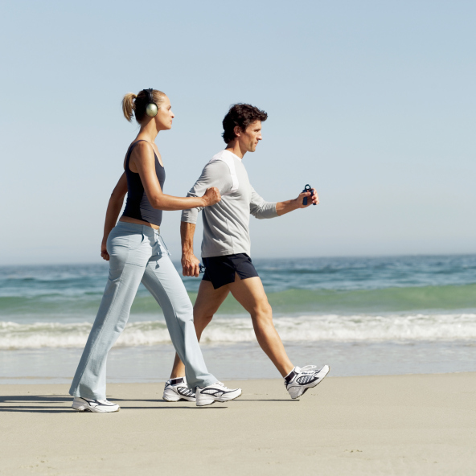
Some final words: Academic writing is to everyday English as ballroom dancing is to walking – it is hard to do really well …
… because:
The brain is not a video camera and it is hard to write about something if you can’t remember the details
Academic language is not everyday language
Who speaks like this in everyday life?
“In determining the best packaging for a food product, it is important to take into account that food quality can deteriorate not only as a result of bacterial or fungal action, but also as a result of chemical reactions.”
See: “Manchester Academic Phrasebank”
Working memory is extremely limited: it can’t cope with trying to organise and put together “1000 pieces of information” at the same time.

Slide 94
So treat writing like sculpting and gradually refine pieces of writing
From this …
… to this …
… takes many steps
The biggest barrier to writing well
is starting to work too late and so not having enough time.

Slide 95
Finally, remember and apply the two keys to success.
1. See writing as part of the thinking process
and write up as much as you can as you go along.
2. Write to convince
and not just describe.
That your research was worth doing
That your methods were sound
That your conclusions follow from your findings
That your conclusions are worth remembering and using.

Slide 96
Learn More

Slide 97
Learn more:
General tips on writing the various sections of scientific papers: https://www.clips.edu.au/wp-content/uploads/scientific-article-guide.pdf
Structuring your scientific paper:
http://origin.www.nature.com/scitable/ebooks/english-communication-for-scientists-14053993/118519636#headerAndCitation
Joshua Schimel (2012), Writing Science: How to Write Papers That Get Cited and Proposals That Get Funded. Library ebook
Margaret Cargill & Patrick O'Connor (2013). Writing scientific research articles strategy and steps. Library ebook
G. Gopen and J. Swan, “The Science of Scientific Writing”: https://cseweb.ucsd.edu/~swanson/papers/science-of-writing.pdf
D. Ridley (2008), The Literature Review: A step-by-step guide for students (Los Angeles: Sage).
The Thesis Whisperer blog: http://thesiswhisperer.com/

Slide 98
Learn more:
Joseph M. Williams, Lessons in clarity and grace.
R.I. Sutton & B.M. Staw (1995), What Theory is Not, Administrative Science Quarterly, 40, 371-384, http://www.jstor.org/stable/2393788. (Despite title, very informative about what theory is and its importance for getting a paper accepted for publication.)
“Turbocharge your writing today”: http://www.nature.com/naturejobs/2011/110707/pdf/nj7354-129a.pdf

